Slide 1
Background
Evolve (accommodate ecosystem changes) by
Substitution
Modification
Substitution requires
Existence of the substitute
Ability to identify the substitutable and a matching substitute
Modification requires
A change prescription
Ability to translate prescription into code change– guidance, template etc.
Modification produces potential substitutes
Modified function f of a class C → new class C→ new component that uses C
Our initial focus is “substitution,” where substitutes already exist
Notes:
How our short term plan situates with the long term goals.

Slide 2
Component, DFU, Models – Part 1
DFUs are the code units that IMMoRTALS manipulate. The simplest evolution is substitution of PLA components, in which case component == DFU
…
x = new X (…);
x.init(…);
…
y= new Y(…);
y.init(…);
…..
x.setNext(y);
….
No single way to point to a “DFU”
No easy way to represent resource description
Class X {
…
…
}
A
B
X
Class Y {
…
…
}
Y
IMMoRTALS is using
JAVA annotation to define the DFUs (e.g., semantic spec is captured as an annotation)
Triple store to catalog DFUs
Resource DSL to describe resource spec
Triple store to store the relationships (models)
Product (Arch Model)
Codebase
Component
DFU
Notes:
Where we are in terms formalizing the proposed concepts and implementing them

Slide 3
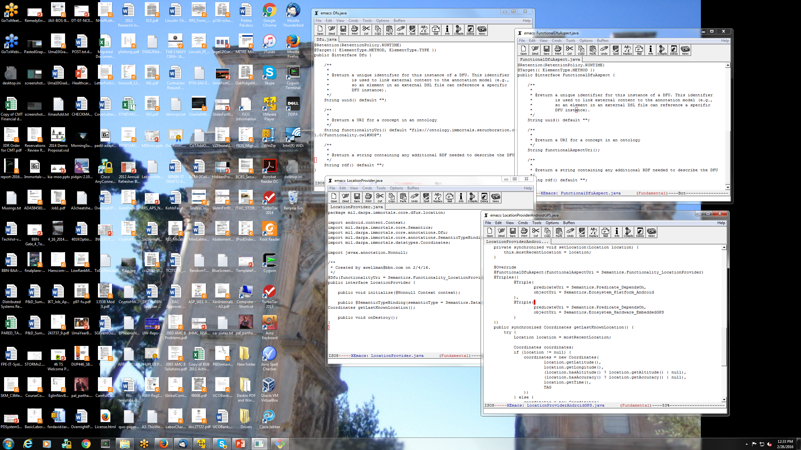

Slide 4
Component, DFU, Models – Part 2
DFUs that are not PLA components– code units that can be evolved to accommodate ecosystem change, e.g., a function in a class
Library or user defined classes
Class X {
M1 m1;
M2 m2;
…
…
M1 f1(…) { … } ;
void f2(…) {
m2 = f1(…);
};
}
Basic type
m1
m2
Output
Output
uses
f1
f2
Easier to point to a DFU, but not enough for modifying f1
Need functional (semantics) and extra-functional (resource) spec (obvious)
May need some representation and dependency of f1’s internal and f1’s relationship in its container (e.g., class) as well (can potentially be on-demand)
Inputs
Inputs
Input types (basic, library or user defined
Code base
Arch model of class
Function
Corresponding DFU

Slide 5
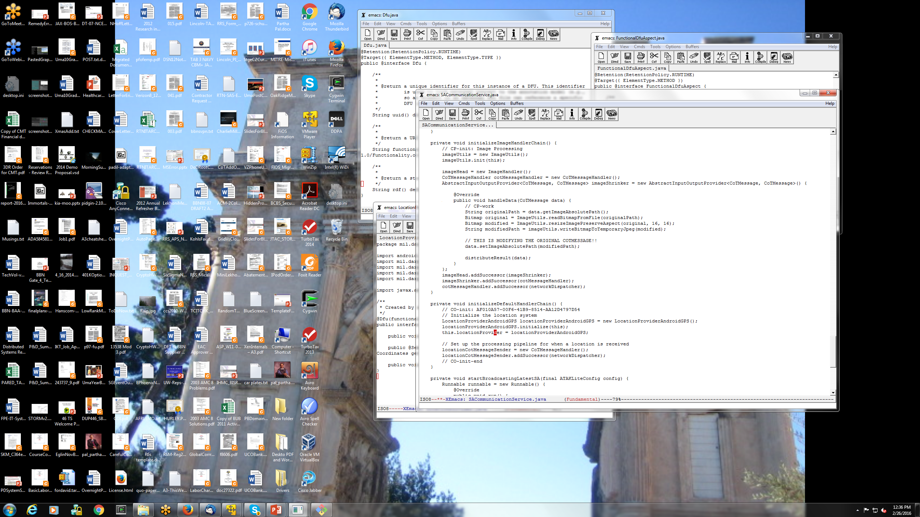

Slide 6
Resource Specification DSL
Overall goal: type system to specify and check the fitness of EFS
A DFU substituting another
A DFU being transformed to create another
Conceptual overview
Atomic DFU: a constant with a resource type A B
DFUs can be composed, a component or a product can thus have a resource type
Application model: function that composes DFUs and applies DFUs to resources
Application instance: all required arguments in the model resolved/assigned
Deployment model: resource type that the application instance should satisfy – inputs: resources provided by the environment – outputs: services defined (required) by the mission requirements
DFU requires resources/services A, provides B
Can be used to answer these questions:
Does this application instance satisfy the deployment model (type checking)
How do we configure the model to produce a valid instance ( type inference)
What is the best configuration for a deployment model (inference+ valuation)
Novel combination of three theories:
Affine type systems: resources are finite, can’t use more that we have
Indexes+ constraints: express constraints and functions on quantities of resources
Variational types: synchronize configuration points across DFUs

Slide 7
DSL Example (Part 1)
DFU Id
Needs memory
Needs GPS sig (non consumable)
LocationProviderAndroidGPS: Mem (m) ! GPSSatSig Mem(m -128) ! LocData
Consumes 128 units of memory to run
Provides location data (semantics)
Resource type of a DFU (e.g., a substitutable component)
Product
A client requires a connection to the hub and consumes uplink and downlink according to the size and frequency of its SA messages, and in the case of downlink also the number of other clients
client: !Hub UL(u) DL(d) UL(u - size*freq) DL(d - n*size*freq) Client
A server requires a connection to the hub and consumes uplink and downlink according to number of clients and the size and frequency of its SA messages
server: !Hub UL(u) DL(d) UL(u – n*(n-1)*size*freq) DL(d - n*size*freq) Server
Resource type of a larger unit (e.g., a client or server application)
Notes:
These are current thoughts, and may evolve. Shortcomings involve global variables, and what if not all clients get all SA messages (different subscriptions)

Slide 8
DSL Example (Part 2)
A sample deployment model for a network with 10 clients and a server
X_10== 10 clients, content in { } are constraints that fix global variables
deploy: !Hub UL(u) Dl(d) X_10 Client Server
{n=10, u=5000, d=5000, size = 20, freq = 1}
An application instance:
λ hub ul dl .
let (ul0, dl0, c0) = client hub ul dl in
let (ul1, dl1, c1) = client hub ul0 dl0 in ...
let (ul9, dl9, c9) = client hub ul8 dl8 in
let (_, _, s) = server hub ul9 dl9 in
(c0, c1, ..., c9, s)
Notes:
Once again– current thoughts

Slide 9
Ontology
What are we modeling now (basic concepts and relations that must be modeled):
Basics/Core
Application (Product), Component, ProductArchitecture, Classes, Functions
Additional concepts related to Java and Bytecode
SA Domain specifics
Image, Location, LocationProvider, ImageProvider, LocationConsumer, ImageConsumer
Ecosystem
Service, Library, Host, Network, CPU, Memory, GPSSignal
Mission
SADataSize, NumClients, ReportingFreq
Immortals specific
DFU, DFUID, SemanticSpec, ResourceType (consumed as well as provided), ControlPoint
Notes:
This is how we are thinking– the ontology is currently generated bottom up (i.e., do what we need and when we need)

Slide 10
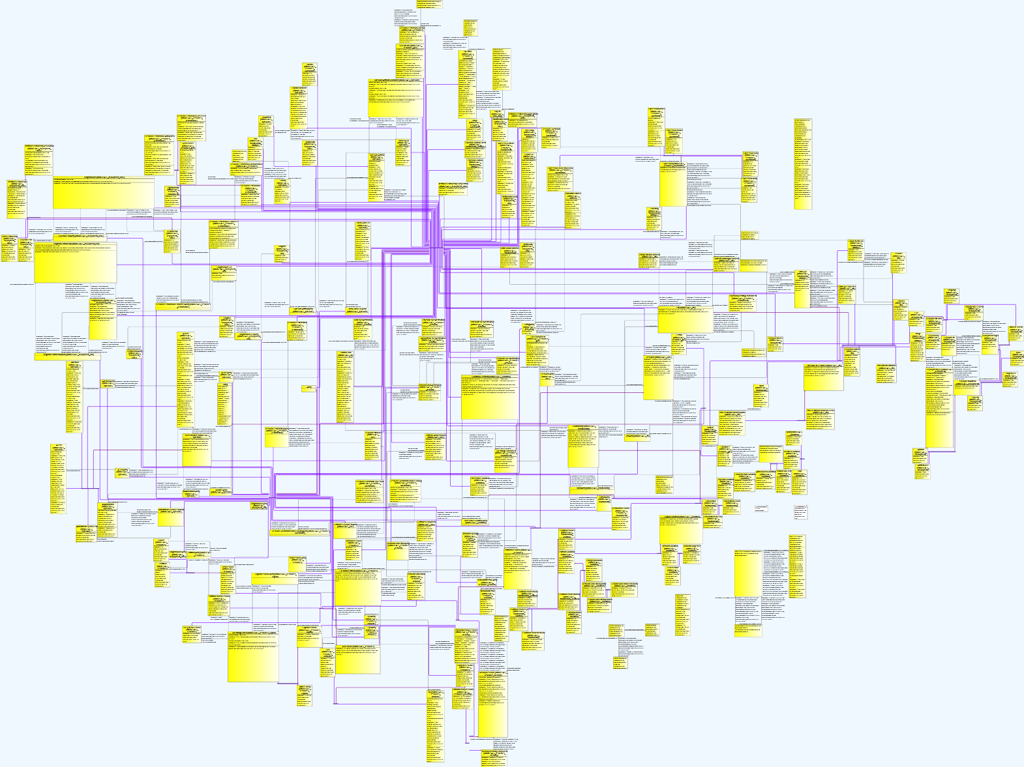
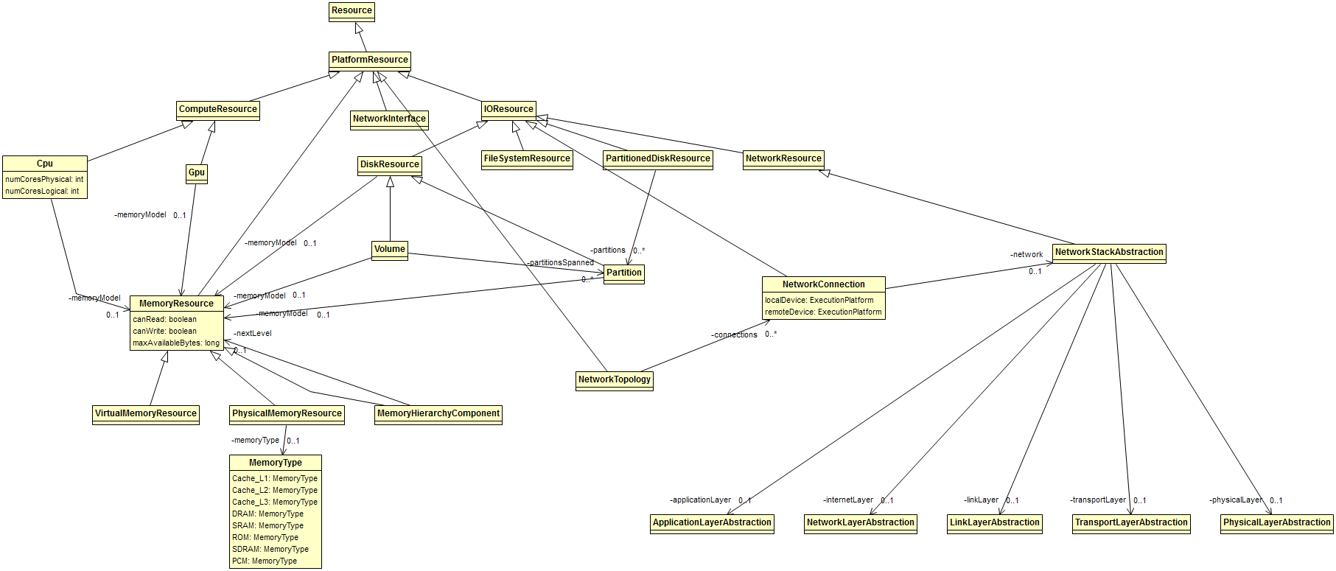
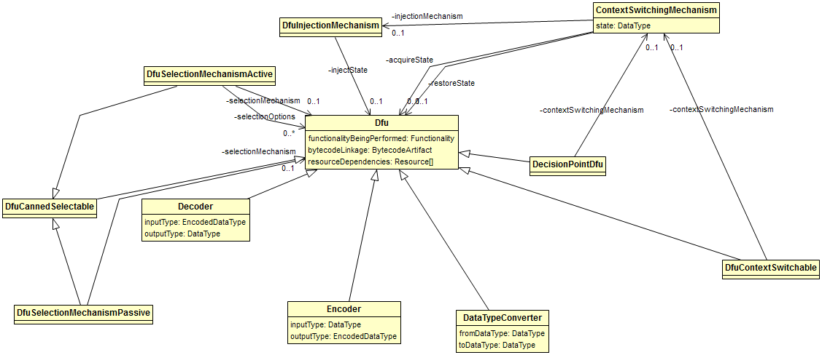

Slide 11
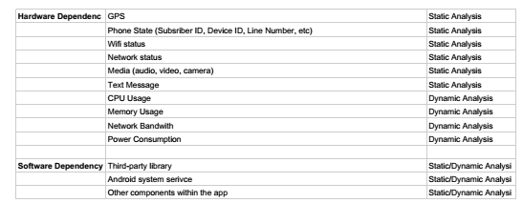
Program Analysis
Overall goal is to do static and dynamic analysis to
Identify program structure
Dependency among structural elements
Input dependency
Resource dependency
The output is consumed by
Constructing the application model
Creating the resource descriptions for DFUs

Slide 12
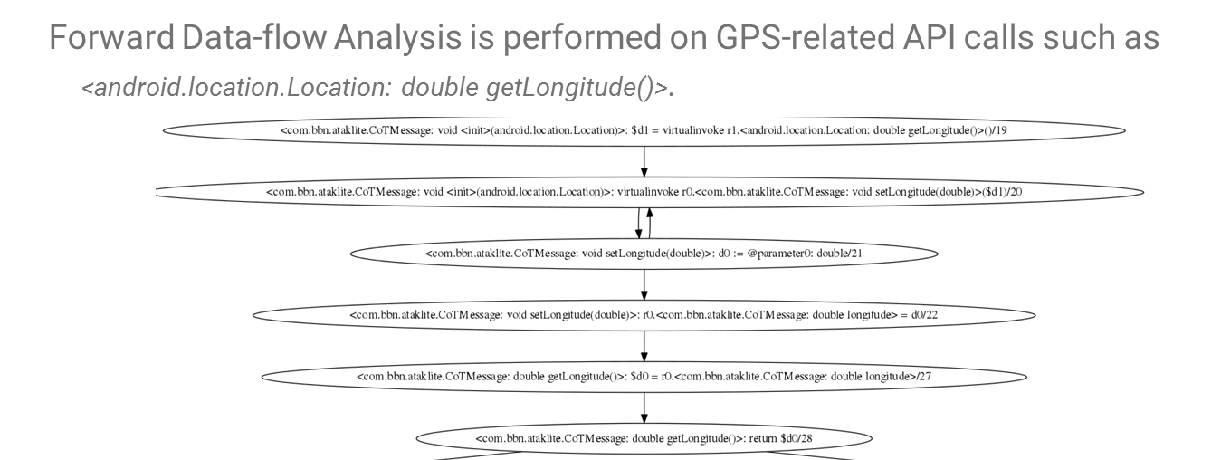
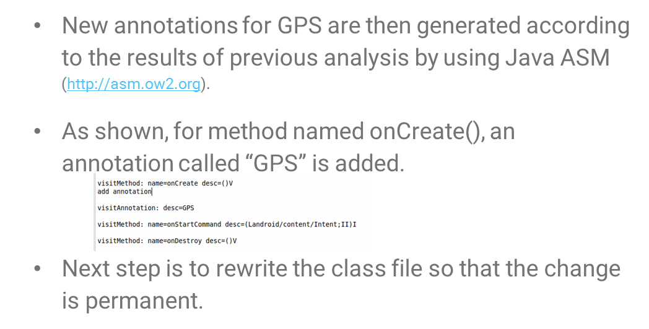
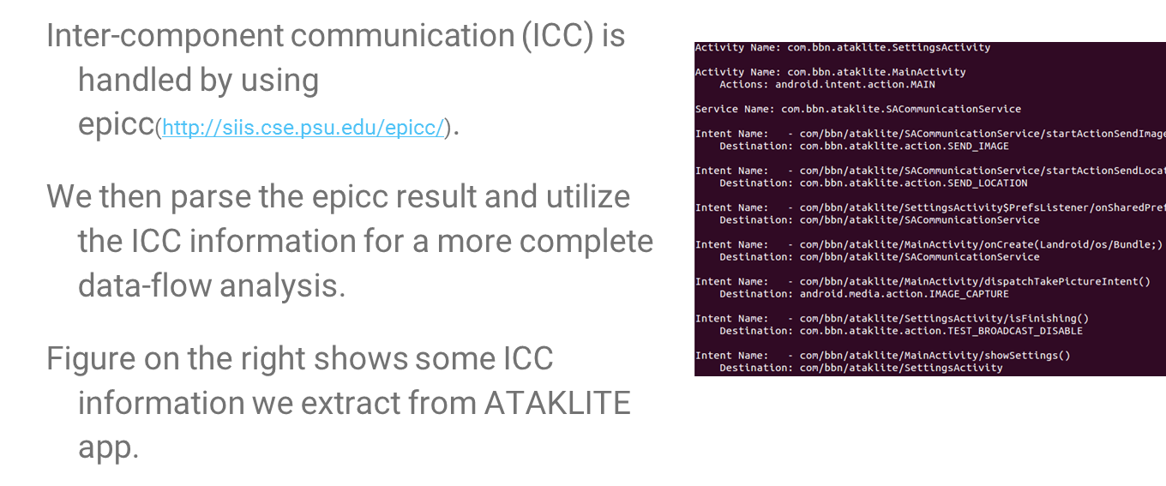
Annotations from Data flow and Inter-Component Communication
Notes:
Current status

Slide 13

Build System (DAS) (1)
Baseline Application Code
DFU implementations (annotations + code artifacts)
…
GPSLoc gps = new GPSLoc(…)
while(true) {
r = gps.getLocation();
sendReport(r);
sleep(x);
}
…
+ GPSLoc & other classes
@func_spec:LocProvider
Class GPSLoc
@init
GPSLoc()
…
@doWork
Location getLocation() {…};
…
@cleanup
@func_spec:LocProvider
Class SAASMLoc
@init
SAASMLoc()
…
@doWork
Location getSAASMLoc() {…};
…
@cleanup
Compilable
Arch Template
(limiting the scope of what can be evolved)
Triple Store
…
//init-CP-1
while(true) {
//doWork-CP-1
sendReport(r);
sleep(x);
}
//cleanup-CP-1
…
Application model
CP:
in Client.java,
template id CP-1
DFU Descriptions
DFU ID 1
Name: SAASMLoc
@f_s: LocProvider
Source: ….java
Dependencies:
DSL File:
DFU ID 2
….
Mission Requirements
Call Freq: 1Hz
Target (deployment)Ecosystem
No GPS Sat, Bandwidth: x
Notes:
Current thought– mission req and target environment description may also be stored in the triple store.

Slide 14
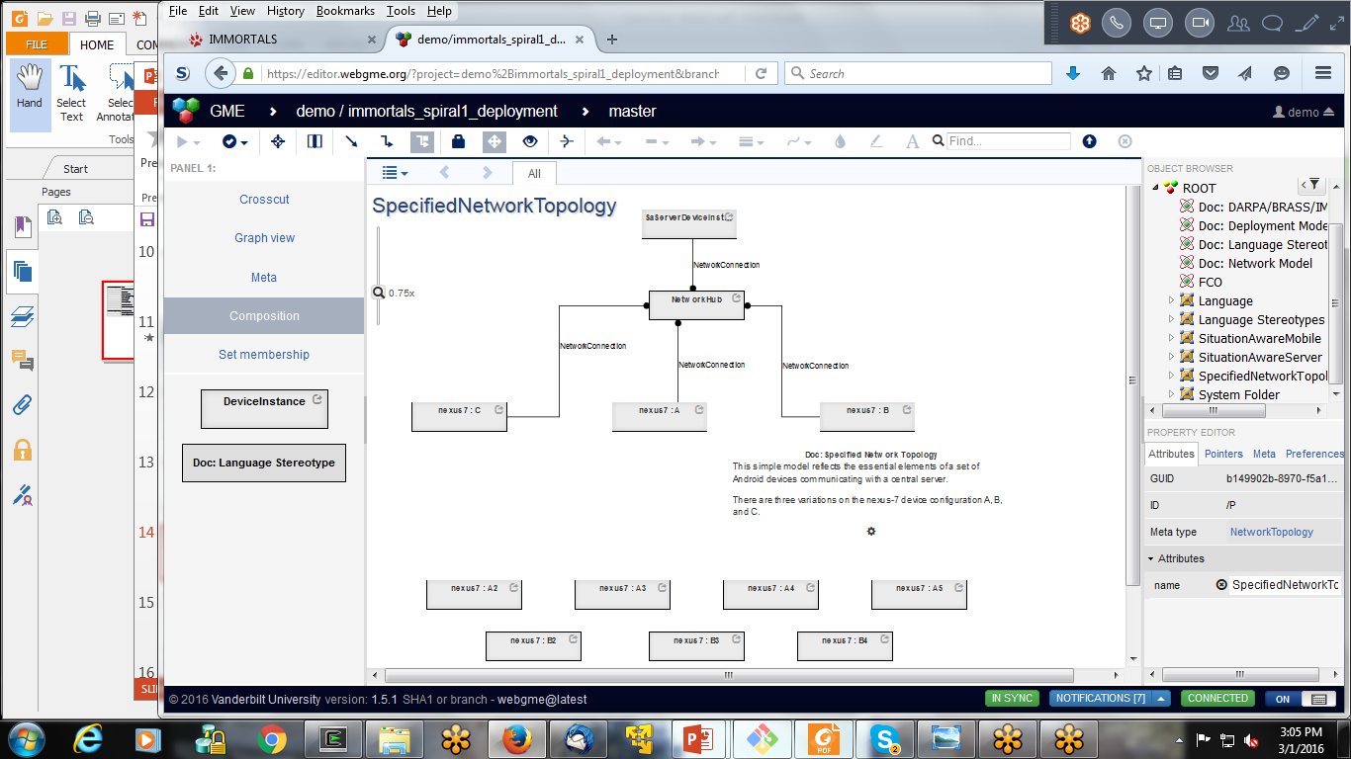
Specifying the Target Environment and Mission Requirement
Notes:
These models are used to test and evaluate and also provides the parameters for our queries (i.e., find a DFU that match)

Slide 15
Build System (DAS) (2) Workflow
Given changes in mission/deployment target
Look up from the RDF store to identify the CPs in the product
which parts of the product can we evolve
Look up from the RDF store which DFU can be used to substitute the existing DFU at that CP (if any) based on semantics (functional spec)
Check the inferred Java/Bytecode signatures match (programming language semantics)
Invoke the DSL check to see if the resource descriptions fit (i.e., 1 hz for the SAASMLoc is less than the available bw)
Build the new product, compile, and test

Slide 16
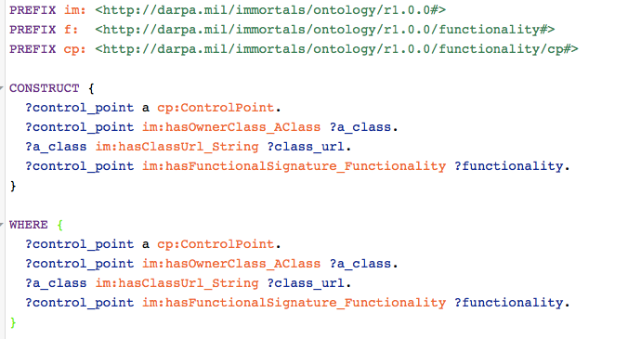
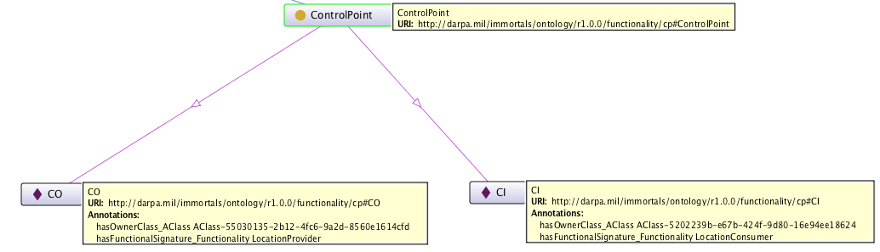
Example Queries (1)
Query the triple store for control points, to retrieve their source files and functionality
Results (shown as an RDF Graph)

Slide 17
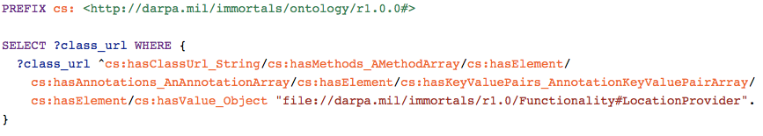
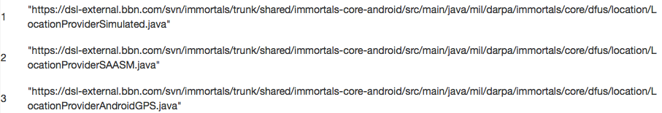
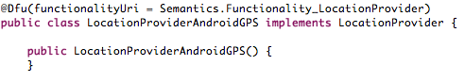
Example Queries (2)
Query the triple store to retrieve the DFUs offering a given functional spec
query
result
The triples/RDF graph that is being queried are created by Bytecode analysis, for example, the annotation below leads to the triple on the right:
LocationProviderAndroidGPS
hasFunctionality
LocationProvider

Slide 18
CPs
CP1: External service dependency (e.g. GPS)
CP2: Mission requirement dependency (number of clients, message rate, message size)
Each CP has various progressions:
Change requested before deployment
DFUs needed to configure an alternate product exists
DFUs needed to configure the alternate does not exist
Change detected at runtime/in-mission
Deployed system is not capable to handle (fails)→ trigger (A)
Deployed system is (has evolved to become due to A and/or B) able to handle
Absorbs within (e.g., executes appropriate branches of code)
Evolves (changes configuration or code, may download)
Our initial focus is (A), and then (B)
In (B) – not claiming that we will be able to synthesize arbitrary programs, the goal is guided instrumentation or transformation of existing code (ordering of arguments, inserting a pipeline element,…)

